Slide 1
AJAX (with Jquery)
Data Representation
Andrew.Beatty@atu.ie
Notes:
This is the knub of it, using AJAX to interact with API that is on a server.

Slide 2
AJAX
Asynchronous: Does not block code, the return function gets called when complete
Javascript: The language
And
XML: Well not much anymore, usually JSON or html is used
More info at https://www.w3schools.com/xml/ajax_intro.asp
We will use AJAX with Jquery not the plain JavaScript version:
https://www.w3schools.com/jquery/jquery_ajax_intro.asp

Slide 3
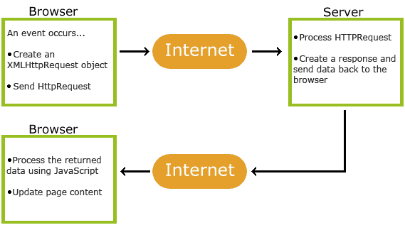
What does AJAX do?
Allows us to call up a resource with HTTP from inside a web page

Slide 4
Consider this JSON
{
"url": "https://api.coindesk.com/v1/bpi/currentprice.json ",
"method":"GET",
"data":"",
"dataType": "JSON",
"success":function(result){
console.log(result);
},
"error":function(xhr,status,error){
console.log("error: "+status+" msg:"+error);
}
}
There are 6 attributes: url, method,data, datatype, success and error
The first four have values of type string
The last two have values of type function

Slide 5
JQuery
We will be using JQuery for AJAX,
JQuery is a javascript library that make finding and manipulating elements in the HTML DOM tree easier.
I am not going into detail about JQuery now
You will need this magic line of code in the header of any page that uses Jquery
<head>
<script src="https://ajax.googleapis.com/ajax/libs/jquery/3.6.1/jquery.min.js"></script>
</head>

Slide 6
$.AJAX function
We will use the $.AJAX function, it takes on parameter, a JSON Object that descrips everything
EG
$.ajax({the object that describes everything});
$.ajax({
"url": "https://api.coindesk.com/v1/bpi/currentprice.json ",
"method":"GET",
"data":"",
"dataType": "JSON",
"success":function(result){
console.log(result);
},
"error":function(xhr,status,error){
console.log("error: "+status+" msg:"+error);
}
}
)

Slide 7
{
"url": "https://api.coindesk.com/v1/bpi/currentprice.json ",
"method":"GET",
"data":"",
"dataType": "JSON",
"success":function(result){
console.log(result);
},
"error":function(xhr,status,error){
console.log("error: "+status+" msg:"+error);
}
}
url : the url to call
method : the HTTP method
data : parameters (none in this case)
dataType : that is returned JSON or HTML or XML
success : the function to call if this is a success (with the result from server)
error : The function to call if we don’t get a status code in the 200s

Slide 8
Putting the code together
<html>
<head>
<script src="https://ajax.googleapis.com/ajax/libs/jquery/3.4.1/jquery.min.js"></script>
<title>
read a simple json
</title>
</head>
<body>
<button onclick="readJSON()">go</button>
</body>
<script>
function readJSON(){
$.ajax({
"url": "https://api.coindesk.com/v1/bpi/currentprice.json ",
"method":"GET",
"data":"",
"dataType": "JSON",
"success":function(result){
console.log(result);
},
"error":function(xhr,status,error){
console.log("error: "+status+" msg:"+error);
}
});
}
</script>
</html>

Slide 9
Read the euro price from the JSON
{
"time": {
"updated": "Oct 25, 2022 14:16:00 UTC",
"updatedISO": "2022-10-25T14:16:00+00:00",
"updateduk": "Oct 25, 2022 at 15:16 BST"
},
"disclaimer": "This data was produced from the CoinDesk Bitcoin Price Index (USD). Non-USD currency data converted using hourly conversion rate from openexchangerates.org",
"chartName": "Bitcoin",
"bpi": {
"USD": {
"code": "USD",
"symbol": "&#36;",
"rate": "19,449.7231",
"description": "United States Dollar",
"rate_float": 19449.7231
},
"GBP": {
"code": "GBP",
"symbol": "&pound;",
"rate": "16,252.0330",
"description": "British Pound Sterling",
"rate_float": 16252.033
},
"EUR": {
"code": "EUR",
"symbol": "&euro;",
"rate": "18,946.8700",
"description": "Euro",
"rate_float": 18946.87
}
}
}
Looking at the JSON you can see the value we are looking for is in the object:
bpi.EUR.rate
So the code to extract it is
var rate = result.bpi.EUR.rate
console.log(rate);
//document.getElementById("output").innerText = rate;

Slide 10
Break time
Summary:
You can call restful APIs from html/javascript pages using AJAX

